Slide 1
Big SQL : Introduction

Slide 2
What Big SQL is
IBM Big SQL is a high performance massively parallel processing (MPP) SQL engine for Hadoop that makes querying enterprise data from across the organization an easy and secure experience.
A Big SQL query can quickly access a variety of data sources including HDFS, RDBMS, NoSQL databases, object stores, and WebHDFS by using a single database connection or single query for best-in-class analytic capabilities.

Slide 3
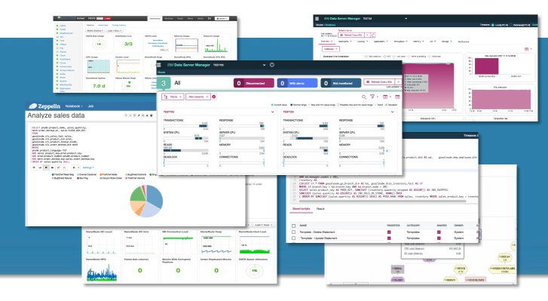
What Big SQL looks like
Big SQL provides tools to help you manage your system and your databases, and you can use popular analytic tools to visualize your data.

Slide 4
How Big SQL works
Big SQL's robust engine executes complex queries for relational data and Hadoop data.
Big SQL provides an advanced SQL compiler and a cost-based optimizer for efficient query execution.
Combining these with a massive parallel processing (MPP) engine helps distribute query execution across nodes in a cluster.

Slide 5
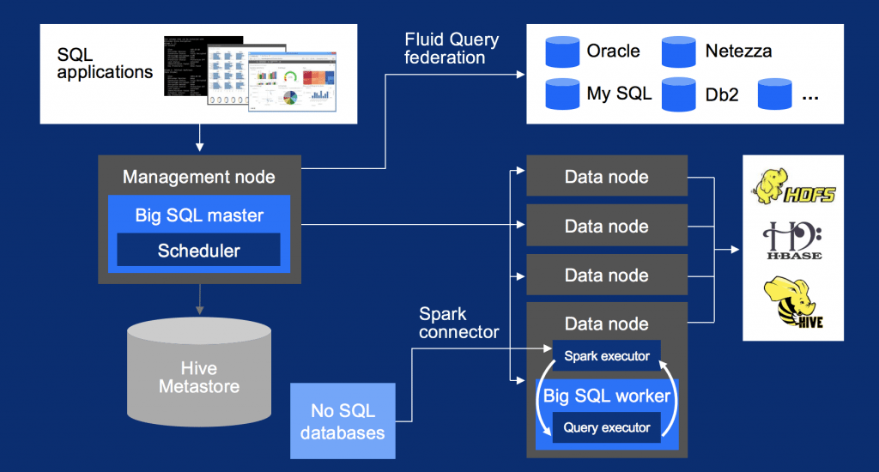

Slide 6
Why Big SQL?
Big SQL provides world-class scalability and performance, and supports the following key use cases:
Enterprise Data Warehouse (EDW) offloading
Big SQL understands commonly-used SQL syntax from other vendors and producers. You can offload and consolidate old data more quickly and easily from existing Oracle, IBM® Db2®, and IBM Netezza® enterprise data warehouses or data marts while preserving most of the SQL from those platforms.

Slide 7
Why Big SQL?
Federated access to relational data
For data that can't be moved to Hadoop, Big SQL provides federated access to many relational database management system (RDBMS) sources outside of Hadoop with IBM Fluid Query technology and NoSQL databases with the use of Spark connectors.
You can use a single database connection to access data across Hadoop and dozens of relational/NoSQL database types, whether they are on the cloud, on local systems, or both.
Wherever the data resides, Big SQL offers data virtualization and enables querying disparate sources in a single query.

Slide 8
Big SQL also boasts:
Elastic boost technology to support more granular resource usage and increase performance without increasing memory or CPU
High-performance scans, inserts, updates, and deletes
Deeper integration with Spark 2.1 than other SQL-on-Hadoop technologies
Machine learning or graph analytics with Spark with a single security model
Open Data Platform initiative (ODPi) compliance
Advanced, ANSI-compliant SQL queries

